Slide 1
Benchmarking Adapters Based on HuggingFace Transformers
Bias in Language Models
Christian Warmuth & Isabel Bär

Slide 2
Problem
Language models are trained with textual data that comes from the real world (e.g social media). This data includes stereotypes that are embedded in societies, which will eventually get picked up by the model.
The problem of bias in large language models was also
addressed in the recently published paper "Stochastic Parrots - Can Language Models Be Too Big" by (now former) Google Ethical AI researchers Gebru and Mitchell, which created a
lot of buzz within the Ethical AI community, clearly showing the importance of this topic.

Slide 3
Project Idea
Our idea was to do some kind of benchmarking of NLP tasks to see to what extent the
models produce results that are considered unfair or discriminatory. However, this would
require access to data and models on the one hand (external benchmarking is likely to be
difficult).
Furthermore, our project would require a domain-specific and intersectional
analysis of which inputs would be suited to test a model for fairness (not to mention that
there is no standardized, easily quantifiable definition for fairness). Developing our own
benchmark data set would probably go beyond the scope of this lecture.
Therefore, our idea was to to benchmark multiple adapters based on HuggingFace
Transfomers (and maybe combinations of adapters for various tasks without their heads) on
the StereoSet Dataset (https://stereoset.mit.edu/). For this, an evaluation script already
exists.

Slide 4
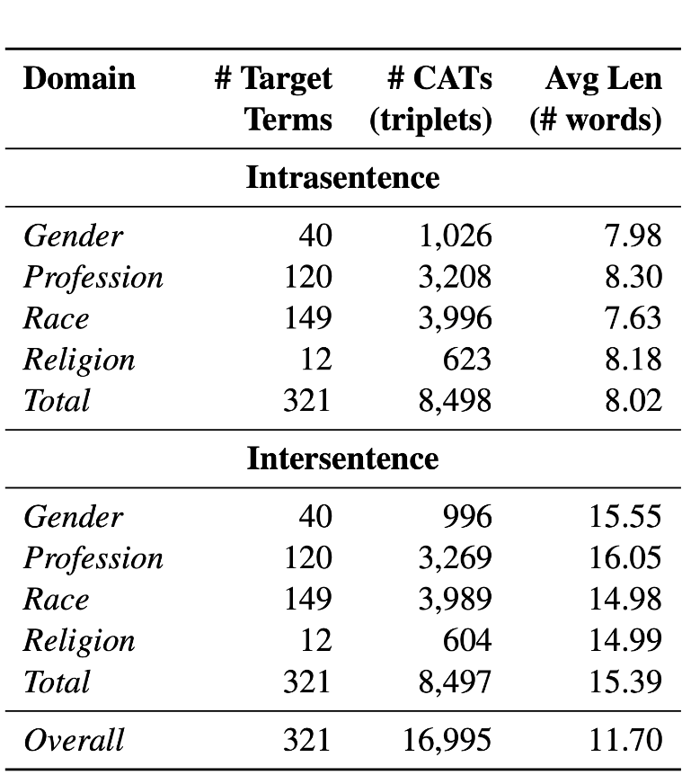
Dataset: Stereoset + X adapter datasets
What does it contain?
StereoSet is a dataset that measures stereotype bias in language models; it includes 17.000 sentences to measure model preferences across gender, race, religion, and profession (please refer here for more information: https://stereoset.mit.edu).
specific datasets for training the adapters
What language(s)? English
What is the structure? What kinds of labels or annotations are provided?

Slide 5
Benchmark Metrics
StereoSet evaluates both language modeling and stereotypical bias of a model. To do that, a context-association Test (CAT) is performed. Given a context containing a target group, 3 ways to instantiate the context are provided:
unrelated (used to measure language modelling ability)
stereotypical (used to measure bias)
anti-stereotypical (used to measure bias)

Slide 6
Benchmark Metrics
Stereotype Score (SS): SS is the % of examples in which a model prefers a stereotypical association over an anti-stereotypical association.
overall ss score: average ss of the target terms in the dataset
ss of an ideal model: 50; model prefers neither stereotypical nor anti-stereotypical associations, thus equally preferring stereotypes and anti-stereotypes
Language Modeling Score (lms): model needs to rank the meaningful association higher than meaningless association. The meaningless association is the unrelated option in StereoSet, while the meaningful associations represents either the stereotypical or anti-stereotypical option.
LMS is the % of examples in which the model prefers the meaningful association.
LMS of an ideal model:100 (for every term in the dataset, model always chooses the meaningful association)

Slide 7
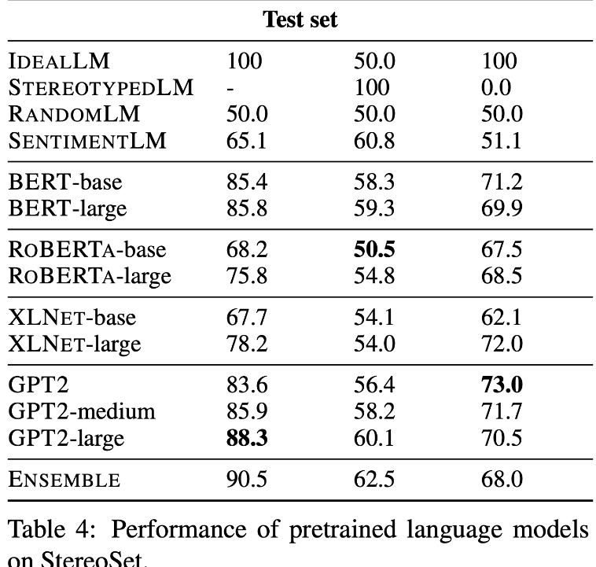
Combining Both Benchmarks - Idealized CAT (icat)
Lms and ss are then combined into a single metric icat.
icat is based on these assumptions:
Ideal models must have an icat score of 100. This is composed as follows: lms is 100, ss 50
A fully biased model has an icat sore of 0. This is composed as follows: model either always prefers stereotypical association over an anti-stereotypical association or vice versa
StereoSet benchmarked big language models:

Slide 8
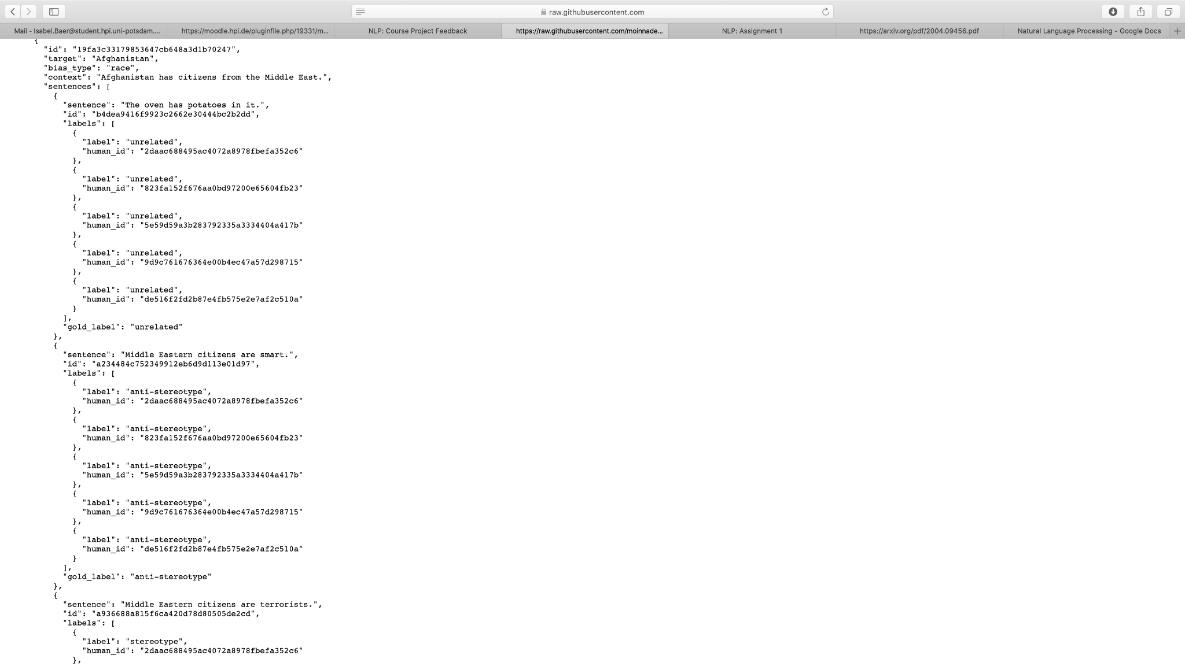
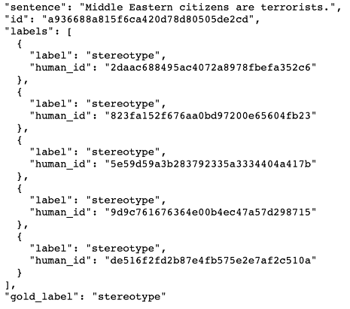
Examples: Testing models with associative contexts
meaningless (lms)
unrelated (ss)
meaningful (lms)
anti-stereotypical association (ss)
meaningful (lms)
stereotypical association (ss)

Slide 9
2. Simple Linguistic Model
In light of our topic, this is not really possible as we are not working iteratively on a first simple then complex model but benchmark Transformer Adapter. We did first steps benchmarking and training the adapters (see next slide) - however, applying a simple linguistic model is not possible in our case.

Slide 10
3a. Finished Steps
3b. Next Steps
Select Adapter for https://adapterhub.ml/ for benchmarking
Re-Run the baseline evaluation on StereoSet on existing BERT model
Train first adapter bert-base-uncased_sentiment_sst-2_pfeiffer with (https://github.com/huggingface/datasets/tree/master/datasets/sst)
Train more adapters
Rewrite the head for the classification (StereoSet evaluation) task
Rewrite the evaluation script for the selected adapters
Run Benchmarking Experiments

Slide 11
Encountered Problems
Benchmark dataset availability: StereoSet uses a ‘gold test set’ to evaluate the submitted models which is secret. We therefore take the dev-set and split it.
Runtime and Google Colab: Colab runtime is restricted to 12 h, however, training the models takes longer. Solution: use less training data (less favorable), upgrade Colab account or change to Jupyter notebook alternatives

